Slide 1
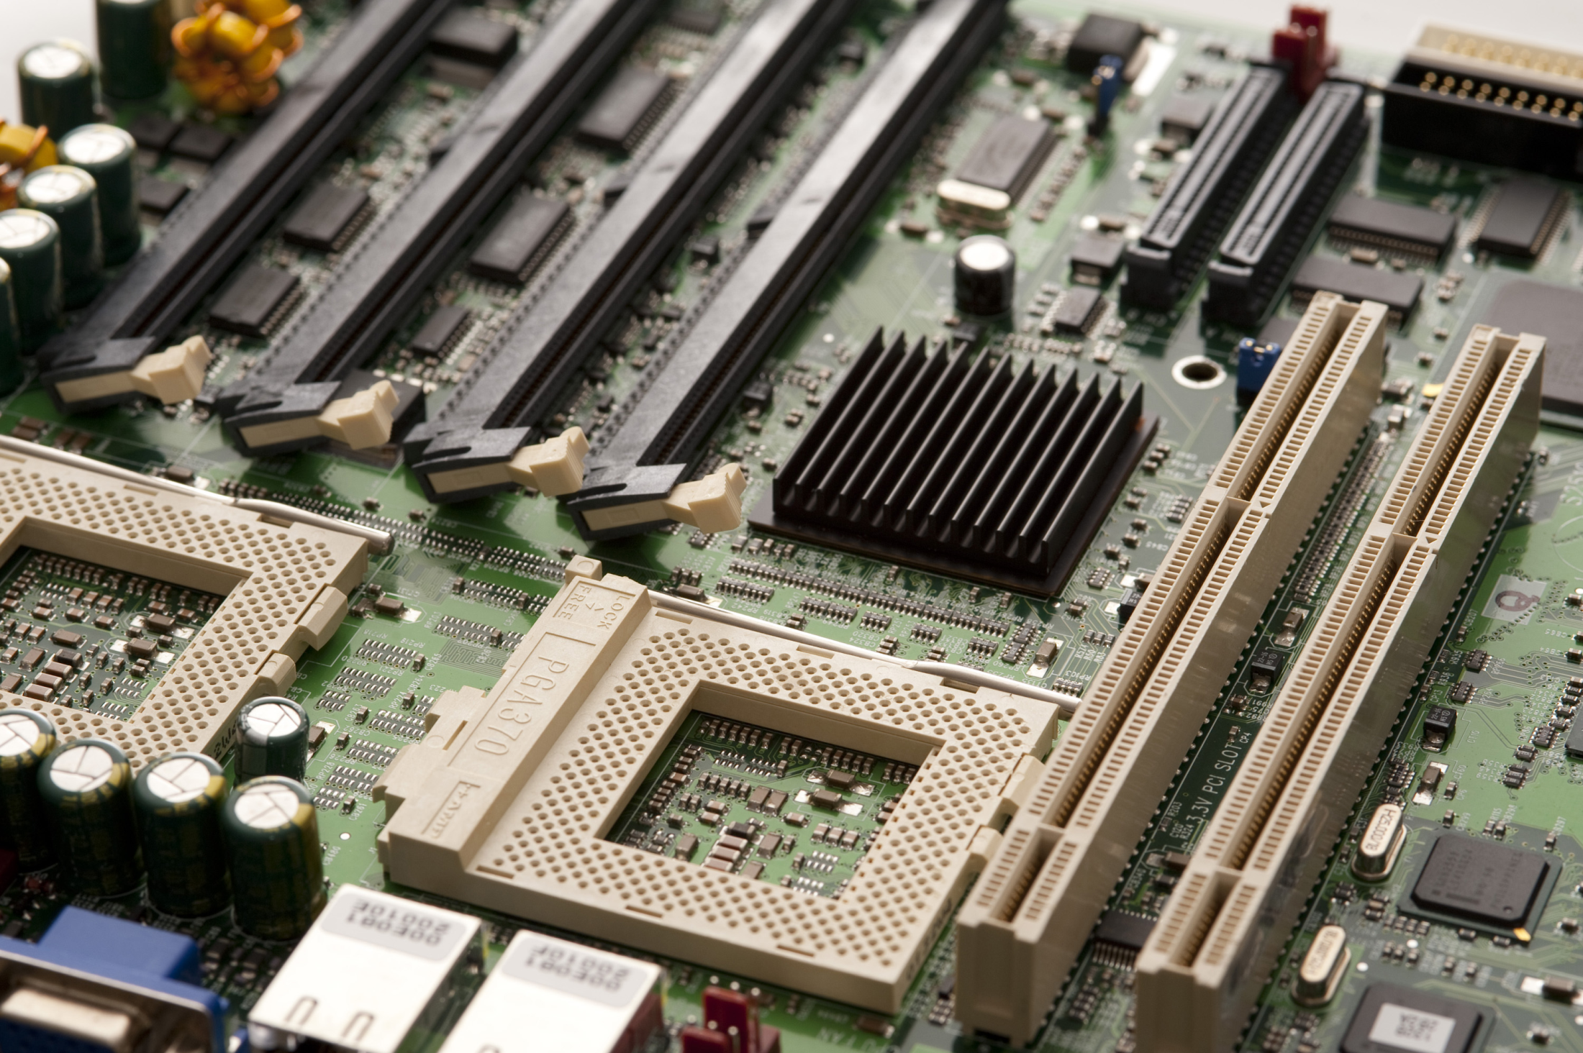
SC1006
Computer Organisation and Architecture
Computer Interfaces - Questions

Slide 2
Which of the signals below is not analog in nature?
Input signal to Digital-to-Analog Converter
Microwave radiation
Audio from headphone
Disco strobe light
B, C and D are real world signals: electromagnetic waves, sound, light, all of which are analog in nature.
Digital-to-Analog converter (DAC) converts digital data to its analog equivalenty, hence its input are digital in nature.

Slide 3
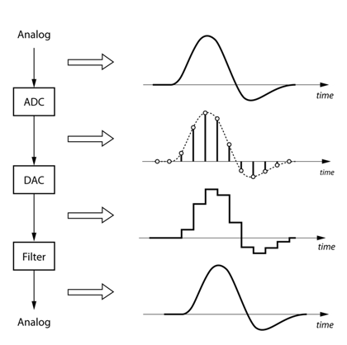
Which of the following sequence is used for processing real world data?
ADC-> Smoothing Filter->Digital Processor->DAC
ADC->Digital Processor-> Smoothing Filter->DAC
DAC-> Smoothing Filter->Digital Processor->ADC
ADC-> Digital Processor->DAC-> Smoothing Filter

Slide 4
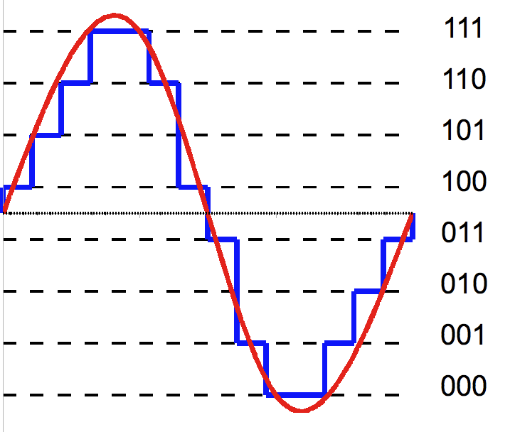
**Which of the following procedure is carried out when digitizing an analog signal?
Sample the voltage level of the analog wave form at fixed time interval.
Limit the voltage range of the analog waveform to +/- 5V
Match the voltage level of the analog waveform to the closest level available in the digital domain.
Analog signal is reconstructed from digital one.
Forcefully reducing the analog voltage level (as B) will distort the analog waveform, hence it is not carried out when digitizing the analog signal.

Slide 5
Which is a more accurate representation of a real world signal?
Analog signal
Digital signal sampled at 1 sec interval
Digital signal sampled at 0.1 sec interval
Digital signal sampled at 0.001 sec interval
Analog signal is equivalent to a digital signal with infinitely small sampling interval.

Slide 6
What is the minimum sampling rate required for a digital signal to be able to represent its analog equivalent adequately?
1X the frequency of the analog signal
2X the frequency of the analog signal
3X the frequency of the analog signal
As fast as the system can support
Nyquist Theorem

Slide 7
Which of the following connection may result in compatibility issue?
A 5V device input pin to 5V device bi-directional pin
A 3V device output pin to a 3V device input pin
A 3V device output pin to a 5V device input pin
A 3V device ground pin and a 5V device ground pin
(C) Electrical Signal level may not be compatible. Specifically, the devices’ VOH/VIH, VOL/VIL parameter values may not be compatible for the logic ‘0’ and ‘1’ to be recognised properly.

Slide 8
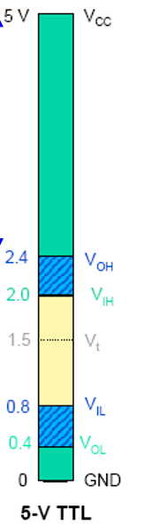
Which conditions are needed for the input device (Din) to sense the logic of the output device(Dout) correctly?
V(OH) of Dout > V(IH) of Din, V(OL) of Dout > V(IL) of Din
V(OH) of Dout < V(IH) of Din, V(OL) of Dout < V(IL) of Din
V(OH) of Dout < V(IH) of Din, V(OL) of Dout > V(IL) of Din
V(OH) of Dout > V(IH) of Din, V(OL) of Dout < V(IL) of Din
VOH => device’s min output voltage level if it is outputting a logic ‘1’
VIH => the min voltage level at its input pin in order of the device to consider the signal as a Logic ‘1’.

Slide 9
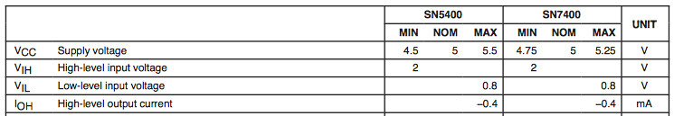
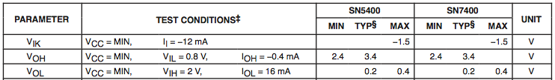
Enter Question Text
A
B
Is the electrical signal level of device B’s output compatible with device A’s input?
Yes
No
B’s min VOH is larger than A’s min VIH value.
Logic ‘1’ can be detected correctly.
B’s max VOL is lower than A’s max VIL.
Logic ‘0’ can be detected correctly.

Slide 10
**Why does differential signal have a better noise tolerance than single ended signal?
Two signals allows redundancy, if one fails, the other could still be used
Higher margin between V+ and V- to differentiate between logic ‘1’ and logic ‘0’
External Interference has the same effect on both the V+ and V- differential signal line so the voltage difference between the V+ and V- signal remains the same approximately
The signal strength of V+ and V- adds up at the receiver, giving raise to higher voltage.
For Differential signal, V+ > V- => Logic ‘1’, V+ < V- => Logic ‘0’.
So there is a larger margin to differentiate between Logic ‘1’ and ‘0’ compared to the single ended signal (using VOH, VIH etc).
Any external influence on the transmission will have the same effect on V+ and V-, so their difference remain more or less unchanged.

Slide 11
**Which of the following scenario(s) will increase the skew between a set of well-behaved signals?
Applying additional serpentine/trombone routing to the PCB traces.
Have different PCB trace width but keep the length constant.
Preserving the PCB trace length and width for each signal in the data bus.
Loading some of the data lines within the same data bus with capacitors.
“Well behaved”: implies that the signal propagation delay in the system has been tweaked so that there is no signal skew among signals that has some dependency (needs to propagate to the receiver simultaneously), e.g. individual data bit lines in a data bus, if no change is made.
So any change in parameters that may alter the propagation delay will increase the signal skew.
Changing PCB width/length will change the overall impedance (resistance, capacitance and inductance) of the system.

Slide 12
Which of the following scenario will result in the most crosstalk?
8 PCB traces running side by side to each other transmitting 1Mhz signal, with ground plane in the PCB layer below.
8 PCB traces running side by side to each other transmitting 10Mhz signal.
8 PCB traces running side by side to each other transmitting 1Mhz signal.
8 shielded cables running side by side to each other transmitting 1Mhz signal
Crosstalk increases as signal frequency increases, interference (crosstalk) on neighbouring signal increases when the lines are close together and when the number of closely packed line increases (more interference sources).
“Ground plane” has voltage potential ‘0V’, it’s the plane form of the ground line. Apart from being used as return path for electrical signal (same as ground line) in single ended transmission, it is also good for absorbing circuit noise.

Slide 13
Which of the following is False?
Parallel bus implementation leads to more bulky cabling compared to Serial Bus.
Parallel Bus is more affected by signal skew and cross talk because of concentration of multiple signals in close vicinity.
Signal Skew and Cross Talk affects the quality of signal transmission, putting a limit on the minimum bus clocking speed.
Parallel Bus interface design tend to be simpler as it only needs a strobe signal.
Signal Skew and Cross Talk will limit the max bus clocking frequency because the effect of Cross talk increases when data signal frequency (proportional to clock speed) increases. Increase in frequency also result in a smaller allowed margin of error (tolerance ) before any signal skew results in wrong data being latched, which means the probability of wrong data latched increases as data signal frequency increases.

Slide 14
Why is parallel bus more prone to cross talk and signal skew compared to serial bus?
Higher transfer rate
More data lines in close vicinity to each other
No clock line to synchronise to
Synchronous in nature
More data lines means more interference sources (more cross talk) and more signal that has dependency among each other (needs to propagate to the receiver simultaneously).

Slide 15
**What limitation(s) does signal skew and cross talk placed on the system design?
Maximum number of lines on the data bus
Maximum clock rate
Maximum number of bytes that can be transferred in one block
Minimum delay between each byte transfer

Slide 16
Advantage(s) of Parallel Bus over Serial Bus
Faster data transfer rate
Faster data transfer rate given the same clock rate
Cable less prone to breaking as there are more wires bundled together
Cable connector more robust as it is bigger.

Slide 17
**Which factor(s) below will cause a change in propagation delay?
Presence of capacitors and inductors in the signal line
PCB trace width
PCB trace length
Bad soldering of components/wires to PCB, thus increasing the resistance of the signal path.
Bad soldering will introduce more parasitic resistance into the system due to poorer electrical connection.
Changing PCB width/length will change the overall impedance (resistance, capacitance and inductance) of the system.

Slide 18
Which of the following is False?
All things equal, Serial Bus can achieve a higher clock rate compared to Parallel Bus.
Given the same clock rate, Serial bus can transfer data further and faster.
Serial bus is less affected by signal skew compared to Parallel bus.
Serial bus implementation is less bulky compared to Parallel bus.
With the same clock rate, Serial Bus suffers less Cross Talk compared to Parallel bus which has more lines (more interference sources). There are also less signal skew (only exist between the serial data bit and its clock), compared to parallel bus with multiple data lines.

Slide 19
If bi-directional data transfers are supported in the system, which of the following Serial transmission will yield the fastest transfer rate?
Half Duplex
Full Duplex
Simplex
Full duplex allows data transfer in both direction simultaneously, so effectively has higher data transfer rate. In half duplex case, some overhead will be incurred when switching data transfer direction.

Slide 20
What is true for synchronous and asynchronous serial transfer?
Synchronous transfer use a common clock line to synchronize data transfer between transmitter and receiver.
Asynchronous transfer does not need any form of synchronization at all to transfer the data.
Asynchronous transfer requires transmitter and receiver to have a prefix transfer clock frequency on a common clock line.
Synchronous transfer does not need a common clock between the transmitter and receiver.
Ansych transfer still needs some form of synchronisation in order for transmission to be reliable, just that they transfer these synch info via the data line.

Slide 21
**Which of the following serial bus(es) are synchronous in nature?
UART
SPI
USB
RS232
RS232 is a transmission standard that uses UART transfer protocol but have a inverted electrical signal standard, i.e. Logic ‘1’ has a lower voltage than Logic ‘0’. RS232 is not in the syllabus for this course.

Slide 22
**Which of the following UART control/data bit(s) has a LOGIC LOW?
Data ‘0’
STOP Bit
START Bit
IDLE State

Slide 23
What is the value of the Parity bit if the number of ‘1’s in the data field is even? Assume Even Parity Scheme is used.
0
1
In Even Parity scheme, transmitter monitors the number of ‘1’s that are transmitted in the Data Field, the transmitter then transmits a ‘1’ or ‘0’ in the parity field so that the total number of ‘1’s in the Data+Parity Field is an Even Number.

Slide 24
What is parity bit used for?
Error Correction
Error Prediction
Error Detection
Error Detection and Correction
The parity scheme in UART can only detect that there are some issues with transmission. It is not able to identify exactly which bit is wrong, and means it also cannot perform error correction. In addition, it cannot detect error with more than 1 bits.

